Slide 1

Data Model - MetaFields
jBilling Academy

Slide 3
Why do we need it
TO DINAMICALLY ENRICH THE JBILLING DATA MODEL(ENTITIES) WITH CUSTOMIZABLE DATA.
APPLIED FOR CUSTOMERS, PRODUCTS, PLANS, ORDERS, PAYMENTS, INVOICES...

Slide 4
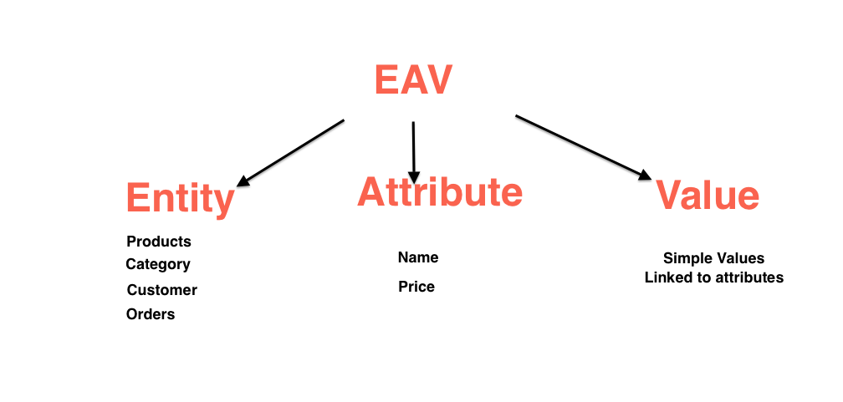
MetaFields - EAV Model

Slide 5
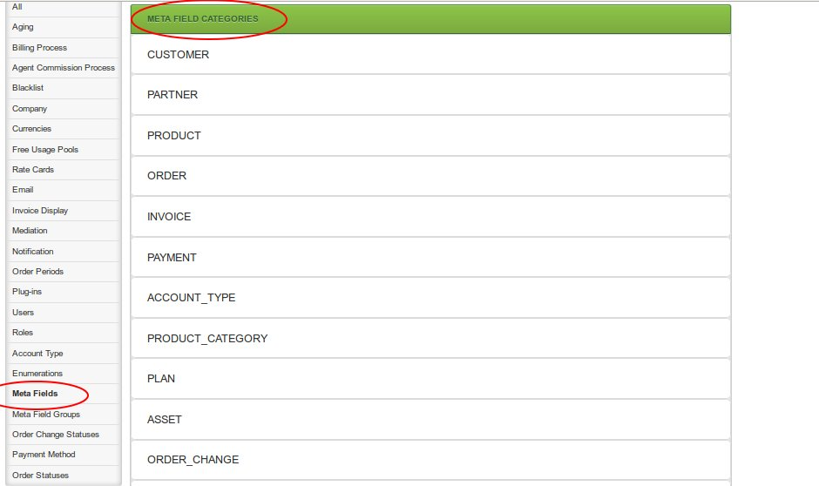

Slide 7
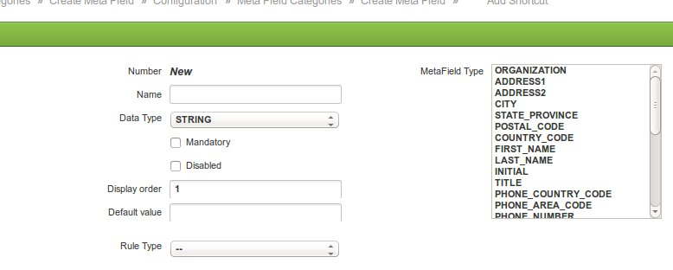

Slide 10
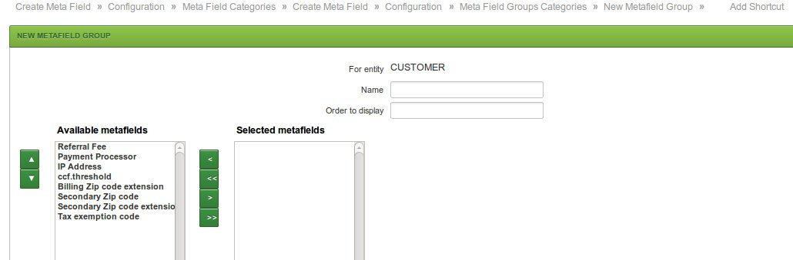

Slide 12
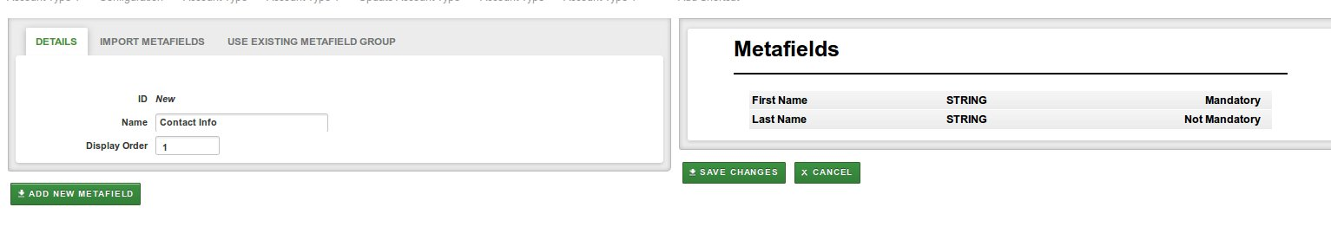
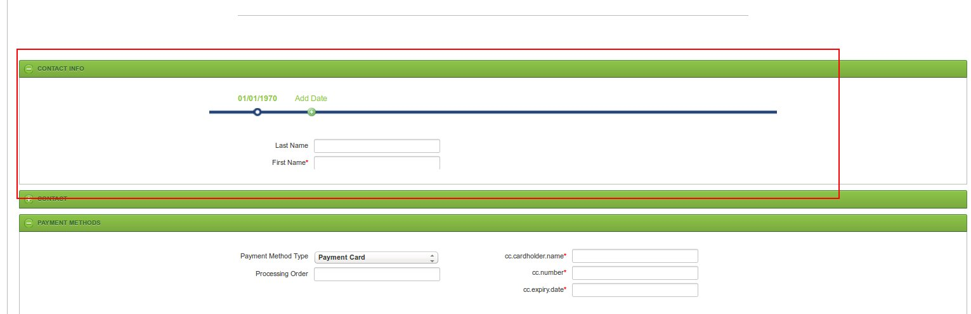

Slide 13
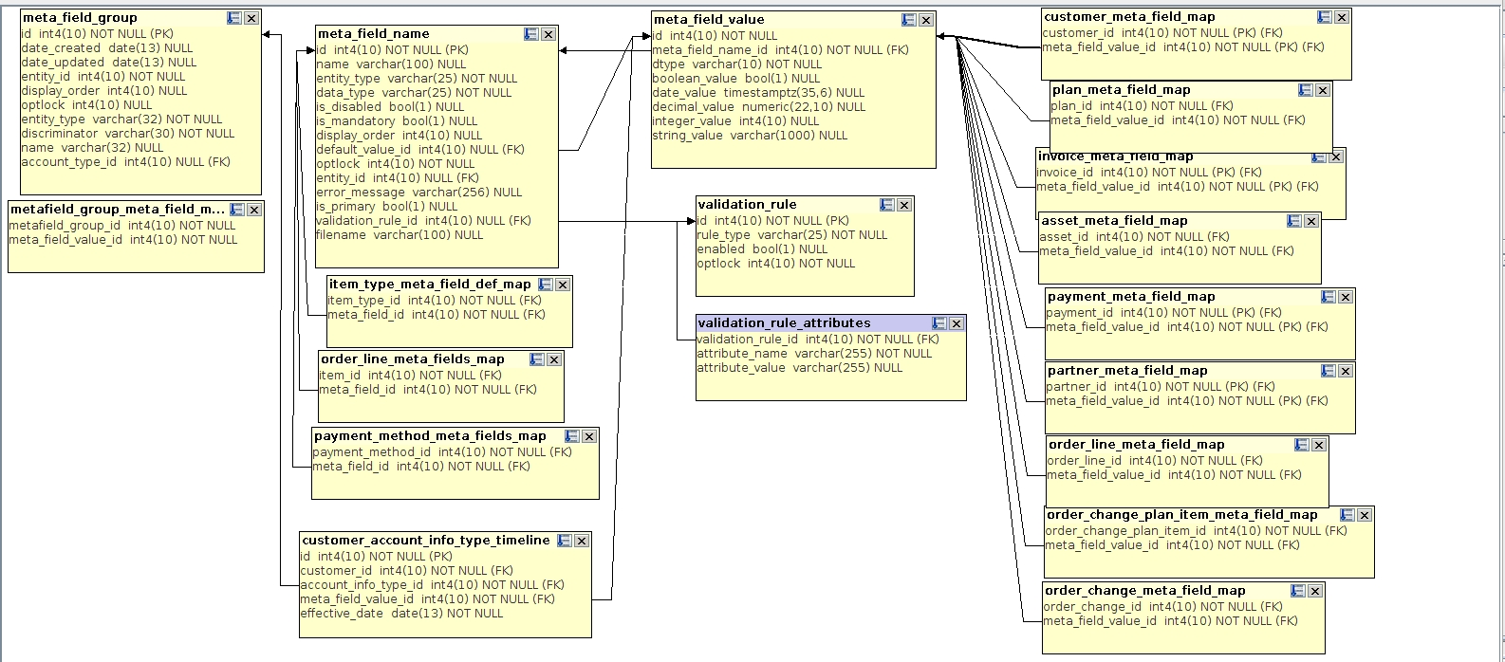

Slide 17

Notes:
<number>

Slide 18
!Thank you!
Notes:
<number>

